Slide 1
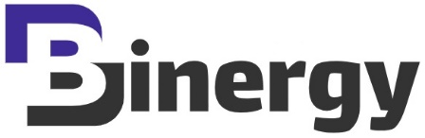
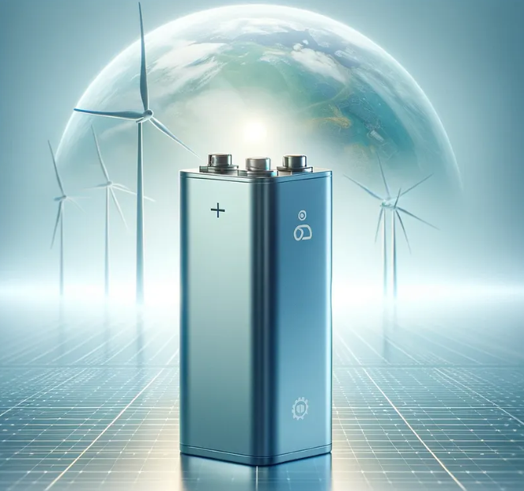
STRATEGIC ENTREPRENEURIAL BUSINESS FRAMEWORK FOR BISMUTH ION SOLID-STATE BATTERY TECHNOLOGY IN THE SPACE ECONOMY & RELATED INDUSTRIES
Mentor: Anthony Nardone
Mentee: Vicente Giliberti
Notes:
Slide 1:
Good morning, I'm Vicente, founder of Binergy, a startup advancing bismuth-ion solid-state batteries for the space economy and related industries. Before sharing my entrepreneurial business framework, I’d like to acknowledge those who helped shape this concept.
Special thanks to Professor Nardone for his amazing support as mentorship, professors D'Alessandro, Ebbers, Ossani, Petrucci, Belingheri, Del Monte, Castelvecchi, Parra, Fraticelli, and La Regina, among others who are no less important.
To my teammates—Suman, Laura, Giannis, Barnabas, Asli, Ilaria, Jacob, and Ricardo.
And finally, to the support team at Luiss Business School Amsterdam—Martina, Alessandro, and Roxana.
Thank you all for your wonderful assistance.
Without further ado, let's begin.

Slide 2
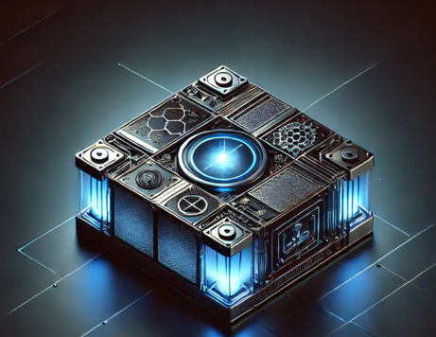
Key Topics Overview:
1. The Problem Statement
6. Summary
2. Value Proposition
5. Financial Outlook
3. Battery Market Overview
4. Project Plan & Funding
Notes:
Slide 2:
Did you know that 90% of the startups fail within the first year? Today we are going to explore how to be in the successful 10%.
OK, to walk you through my journey in this business plan, I'm going to be covering these key topics in the briefing today.
What's the problem statement?
How do we go ahead and put together a value proposition to adjust the industry?
What does that market look like?
How did I put together a concept to get us through the project development and to the point where we could bring products to market?
What does that finally financially mean to you as an investor and or to the project as a whole?
and then we're going to summarize and close the presentation.

Slide 3

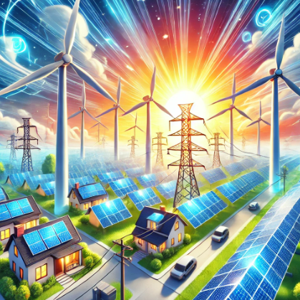
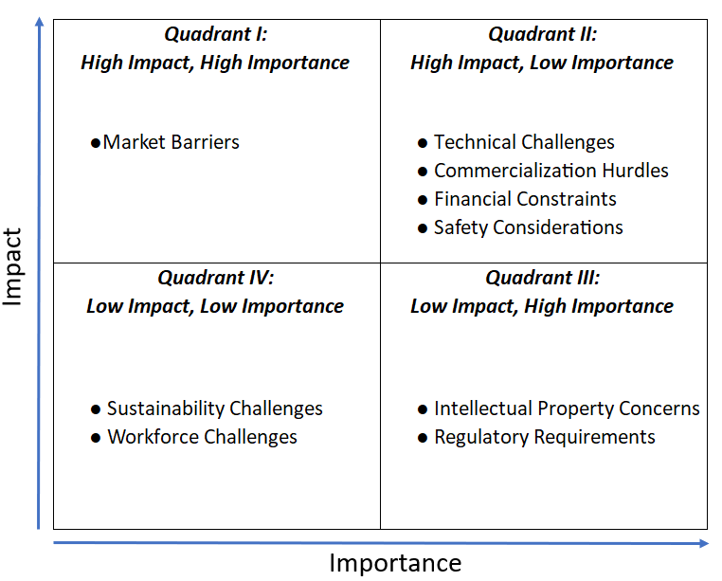
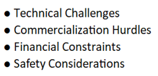
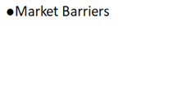

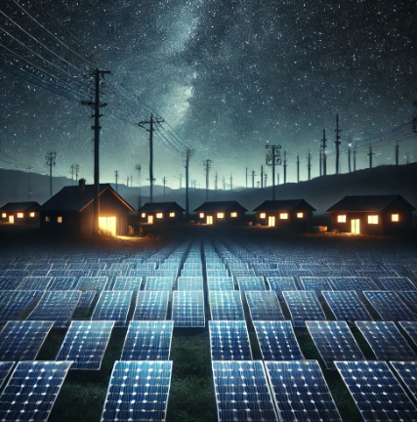

The Problem Statement:
“Intermittent nature of wind and solar renewable energy supplies”
Innovative idea:
Bismuth Solid State Batteries (BIBs)
Wind and Solar energy sources actively providing power during windy days and daylight. [2]
Startup Challenges Impact-Importance Diagram
Energy consumption when wind turbines stand still due to the lack of wind. [2]
Requirement: Energy Storage
Energy consumption during nighttime, with solar panels inactive due to the absence of sunlight. [2]
Requirement: Energy Storage
Notes:
Slide 3:
The problem is clear: when there's no wind or sun, we need a way to generate and sustain energy. That’s where bismuth solid-state batteries come in.
My goal in developing this plan was to tackle key challenges where I can make the greatest impact. Using a framework that evaluates impact and importance, I prioritize high-impact, high-importance solutions, tackling challenges such as technical, commercialization, financial, and safety, while also addressing lower-priority factors.
Now, let me show you exactly how I’ve addressed these challenges in my planning. But first, let’s look at the market solution from a customer perspective.

Slide 4



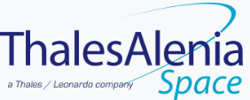






VALUE PROPOSITIONS CANVAS:
Designed for: providing a concise and visual framework for understanding and optimizing Binergy’s value Proposition in the realm of SSB for several industry customers.
[68]
Designed by: Vicente Giliberti.
Date: 02/06/2024
Version: 1.0
PRODUCT
CUSTOMER:
Space Agencies, Satellite Manufacturers, Space Launchers, Renewable Energy Suppliers, EV manufacturers, between others.
1) Benefits
2) Experience
Advanced Bi-ion Solid-State Batteries:
● Long-lasting efficiency for extended range and durability.
● Superior safety and reliability for peace of mind.
● Eco-friendly, reducing environmental impact.
Cost-Effective Solutions:
● Affordable, high-quality batteries.
● Long-term savings from reduced replacements.
4) Gains (Want)
5) Pains (Fears)
Customized Energy Storage Solutions:
Strategic Partnering for tailored energy storage solutions design.
Perpetual support, optimization and maintenance to maximize efficiency.
Ensuring battery reliability in extreme environments.
Seamless integration of high-performance batteries.
Long-lasting, high-energy-density batteries.
Efficient energy integration and scalability.
Cost-effective, sustainable, and innovative.
.
Uncertain performance and reliability.
Limited storage for extreme conditions.
High costs and low energy density.
Sustainability and cost barriers.
3) Features
Advanced Bi-ion Solid-State Batteries:
● High energy density for extended range and durability.
● Safe, reliable, eco-friendly materials in production and use.
Cost-Effective Solutions:
● Efficient manufacturing and sustainable sourcing lower costs.
● Quality assurance ensures lasting performance.
Provide durable, and sustainable energy for high-demand applications.
Ensure safe, high-performance energy for advanced systems.
Enable efficient renewable storage for seamless integration.
6) Jobs Addressed (Needs)
Notes:
Slide 4:
Let’s look at Binergy’s value proposition.
I used the Value Proposition Canvas from Professor D’Alessandro’s class to align our product with customer needs.
First, the benefits of bismuth-ion solid-state batteries—they offer efficiency, safety, reliability, and eco-friendliness.
From the experience perspective, strategic partnerships ensure long-term support and optimization.
For features of bismuth-ion solid-state batteries, they are characterized by higher energy density and cost-effective solutions.
Finally, the customer perspective helps us understand what they want, fear, and need, allowing us to build a holistic solution for the market.

Slide 5

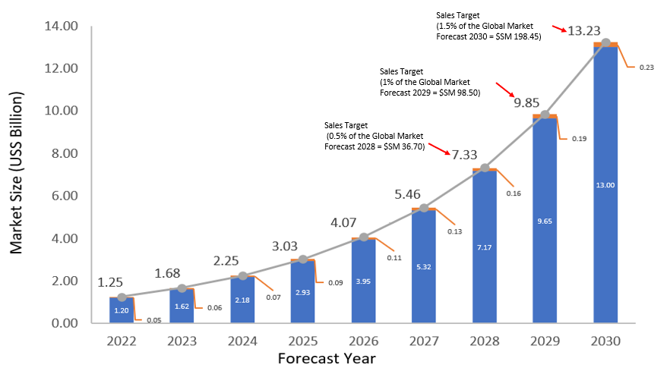


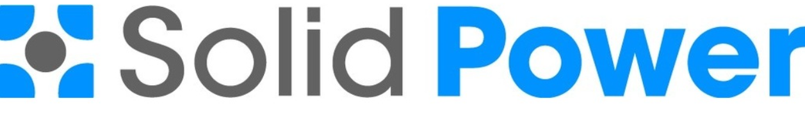


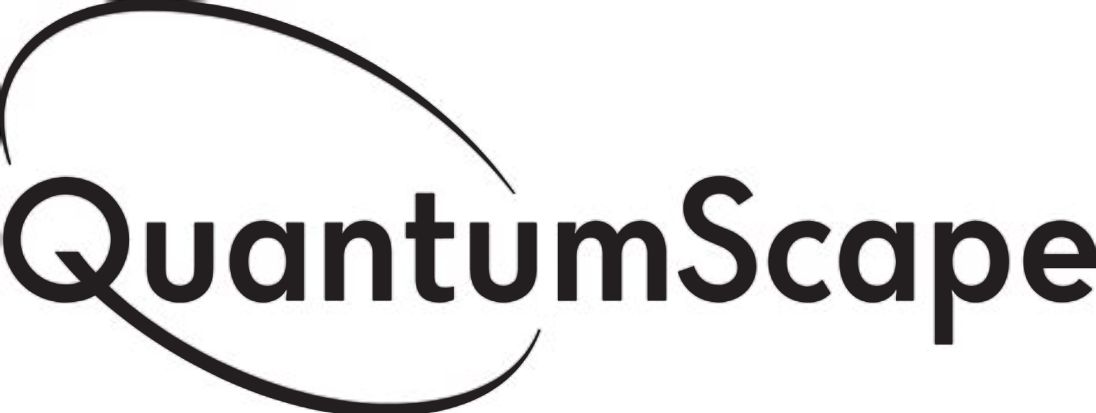





Global Solid-State Battery Market Growth
130 Starship rockets
Non- Space Sector
Space Sector
Key Players / Main Competitors
26,000 Lamborghini Aventadors
[20]
[21]
[22]
[23]
Actual
Forecast
Notes:
Slide 5:
"This chart illustrates the global solid-state battery market growth from 2022 to 2030. The market is expected to grow from $1.25 billion in 2022 to $13.23 billion by 2030, with Binergy’s target market clearly highlighted.
Currently, in 2025, the market is at $3 billion. By 2028, it's projected to reach $7.3 billion, where we aim to capture 0.5% ($36.7 million). By 2029, we target 1% ($98.5 million), and by 2030, 1.5% ($198.45 million).
The financials that we are following are going to be based on those assumptions.

Slide 6
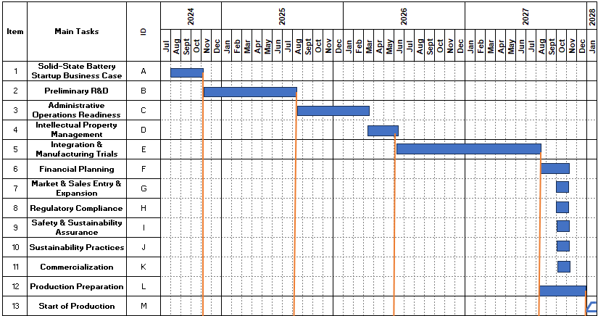
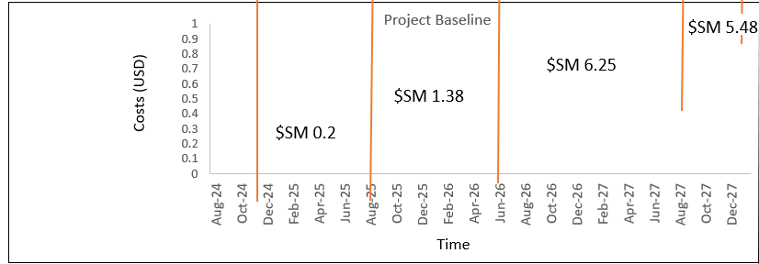

Project Baseline & Funding Overview
15/02/2025
Expenses covered by the entrepreneur
(F6)
(F1)
(F4)
(F5)
(F6)
Funding Stage 1
(F2)
Funding Stage 4
Funding Stage 6
$M 54.35
First year of Production (2028)
Funding Stage 2
(F3)
Funding Stage 5
Funding Stage 3
$0 ??
$M 0.2
$M 6.25
$M 1.38
$M 5.48
F1+F2+F3+F4+F5 = Fproject = $M 13.31
Fproject + F6 = Finvest = $M 67.70
Notes:
Slide 6:
Coming back to how we address the challenges, a project plan with actionable steps has been established to address them. The goal is to define Binergy's project baseline (time, cost, and scope).
The project runs from July 2024 to December 2027, with full-scale production expected in early 2028.
The total budget is $13.3M, with estimated first-year production costs of $54.35M, requiring $67.65M in funding from investors, grants, and partnerships.
The scope covers all phases from Preliminary R&D to Manufacturing Trials, ensuring an efficient path to market readiness.
The progressive funding approach offers key benefits, including risk management, capital efficiency, and better decision-making, making it ideal for long-term, capital-intensive projects.

Slide 7
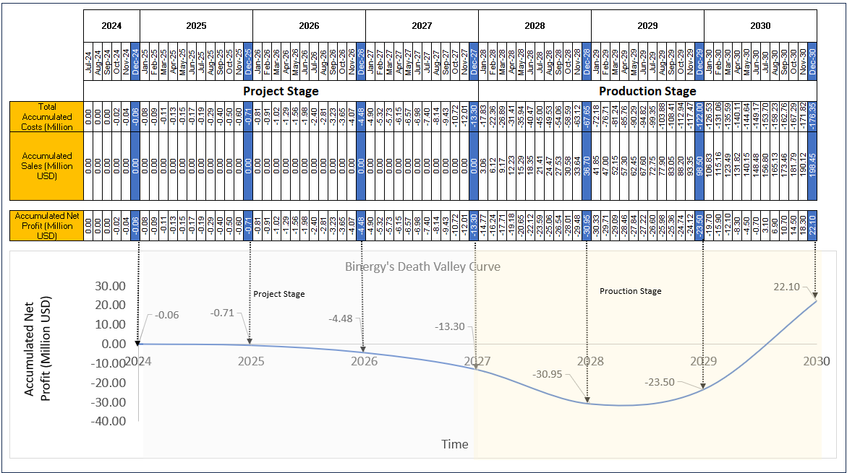
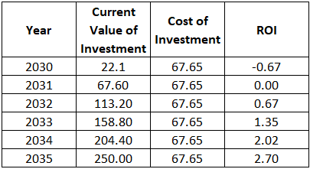

Financials
Sales Target (0.5% of the Global Market Forecast 2028
Sales Target (1% of the Global Market Forecast 2029
Sales Target (1.5% of the Global Market Forecast 2030
Total Investment
Projected ROI beyond 2030
Breakeven Point
Notes:
Slide 7:
OK, in this slide, I’ll briefly explain our project’s development phase and expected ROI progress.
From 2024 to 2028, we’re in the development phase, so there’s no revenue, and our ROI will be negative. As shown in the chart, the graph reflects this initial downward trend. However, once production starts in 2028, we aim to capture 0.5% of the global market and will begin generating revenue, causing the trend to turn upward, growing to 1% in 2029 and 1.5% in 2030.
We expect to break even by mid-2029, about five and a half years after starting development. From there, our ROI will turn positive and continue to grow as we scale up.
The table on the right shows a projection of ROI growth from 2030 to 2035.

Slide 8
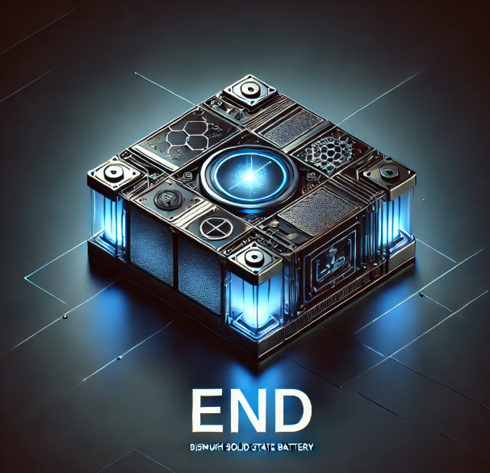
Summary & Call to Action
The Problem:
Lithium-ion battery limitations hinder energy density, cost, and safety.
The Solution:
Binergy's Bismuth-Ion Batteries: non-toxic, high-performance, cost-effective and safe.
Market Opportunity:
Solid-state battery market to grow to $13.23 billion by 2030 (CAGR: 34.3%), targeting 0.5% of sales for 2028, 1% by 2029 and 1% by 2030
Execution Plan:
Project budget: $13.3 million (2024-2027)
Total funding needed: $67.65 million
Production cost (by 2028): $54.35 million
Target revenue: $22.1 million by 2030 (1.5% of market)
Financial Projections:
Breakeven: 2030
ROI: 0.67 by 2032, 1.35 by 2033, 2.64 by 2035
Investor Interest: Clear path to profitability and strong ROI projections, making it a compelling long-term investment.
“Let’s shape the energy landscape of tomorrow, today."
Notes:
Slide 8:
In conclusion, Binergy addresses the critical limitations of lithium-ion batteries with its innovative Bismuth-Ion technology, offering a non-toxic, high-performance, and safe alternative. With the solid-state battery market poised for significant growth, Binergy aims to capture 1% of market sales by 2030, supported by a strategic plan requiring $67.65 million in funding. The company projects breakeven by 2030 and promising ROI, making Binergy an attractive long-term investment opportunity in the rapidly evolving energy storage landscape.
“Let’s shape the energy landscape of tomorrow, today."

Slide 9



Notes:
Slide 9:
Thank you very much for your time, I sincerely appreciate your presence, and I look forward
to your questions.

